Slide 1
Murach’s Modern JavaScript
Chapter 3
How to code control statements

Slide 2
Objectives
Applied
Code conditional expressions that use relational and logical operators.
Control the flow of an app using if statements, switch statements, and the conditional operator.
Repeatedly execute blocks of code using while, do-while, and for loops.
Knowledge
Differentiate between the equality and strict equality operators.
Name two short-circuit operators and explain how they work.
Describe the order of precedence for evaluating a compound conditional expression.
Describe how nesting statements works.
Differentiate between true and false values and truthy and falsy values.
Describe the use of break and continue statements within a loop.

Slide 3
The relational operators
Operator | Description
== | Equal to
!= | Not equal to
=== | Identical to
!== | Not identical to
> | Greater than
< | Less than
>= | Greater than or equal to
<= | Less than or equal to

Slide 4
Conditional expressions
lastName == "Hopper"
testScore == 10
firstName != "Grace"
months != 0
testScore > 100
age < 18
distance >= limit // compare a variable
stock <= reorder_point // and a constant
rate / 100 >= 0.1 // compare an arithmetic
// expression to a literal
10 == "10" // true
10 === "10" // false
null == undefined // true
null === undefined // false

Slide 5
Equality and type coercion
The equality operator (==) and the inequality operator (!=) perform type coercion when comparing values of different data types. That means they convert (coerce) data from one type to another so they can be compared.
The strict equality operator (===), also called the identity operator, and the strict inequality operator (!==) do not perform type coercion. If the two operands are of different types, the result will always be false.

Slide 6
The isNaN() function
isNaN(expression)
Two expressions that use the isNaN() function
isNaN("Hopper") // Returns true since "Hopper"
// is not a number
isNaN("123.45") // Returns false since "123.45"
// can be converted to a number

Slide 7
The logical operators
Operator | Name
&& | AND
|| | OR
! | NOT
Short circuit operators
The AND and OR operators are known as short circuit operators because they only evaluate the second expression if necessary.

Slide 8
Three compound conditional expressions that use logical operators
The AND operator
age > 17 && score < 70
The OR operator
isNaN(rate) || rate < 0
The NOT operator
!isNaN(age)
Order of precedence
NOT operator
AND operator
OR operator

Slide 9
The syntax of the if statement
if (condition-1) { statements }
[ else if (condition-2) { statements }
...
else if (condition-n) { statements } ]
[ else { statements } ]

Slide 10
An if statement with an else clause
if (age >= 18) {
alert("You may vote.");
} else {
alert("You are not old enough to vote.");
}

Slide 11
An if statement with else if and else clauses
if (isNaN(rate)) {
alert ("You did not provide a number for the rate.");
} else if (rate < 0) {
alert ("The rate may not be less than zero.");
} else if (rate > 12) {
alert ("The rate may not be greater than 12.");
} else {
alert ("The rate is: " + rate + ".");
}

Slide 12
An if statement with a compound conditional expression
if (isNaN(userEntry) || userEntry <= 0) {
alert ("Please enter a valid number " +
"greater than zero.");
}

Slide 13
Two ways to test if a Boolean variable is true
if (isValid == true) { }
if (isValid) { } // same as isValid == true
Two ways to test if a Boolean variable is false
if (isValid == false) { }
if (!isValid) { } // same as isValid == false

Slide 14
An if statement that contains two nested if statements
let discountPercent = 0;
if (customerType === "r") {
if (invoiceTotal >= 100 && invoiceTotal < 250) {
discountPercent = .1;
} else if (invoiceTotal >= 250) {
discountPercent = .2;
}
} else if (customerType === "w") {
if (invoiceTotal < 500) {
discountPercent = .4;
} else if (invoiceTotal >= 500) {
discountPercent = .5;
}
}

Slide 15
An if statement that gets the same results
let discountPercent = 0;
if (customerType === "r" &&
invoiceTotal >= 100 && invoiceTotal < 250) {
discountPercent = .1;
} else if (customerType === "r" && invoiceTotal >= 250) {
discountPercent = .2;
} else if (customerType === "w" && invoiceTotal < 500) {
discountPercent = .4;
} else if (customerType === "w" && invoiceTotal >= 500) {
discountPercent = .5;
}

Slide 16
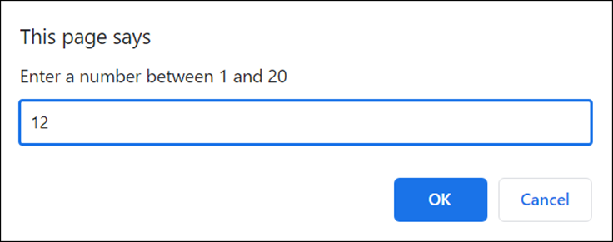
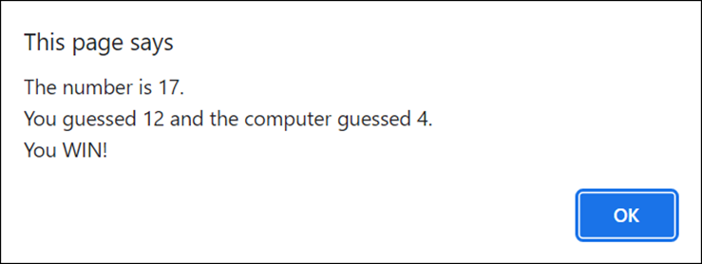
The dialogs for the Guess the Number app
Ask the user for a number
Display the guess results

Slide 17
JavaScript for the Guess the Number app (part 1)
// get a random number between 1 and 20
const num = Math.ceil(Math.random() * 20);
// get the computer's guess
const computerGuess = Math.ceil(Math.random() * 20);
// get the user's guess
const userGuess =
parseInt(prompt("Enter a number between 1 and 20"));
if (isNaN(userGuess)) {
alert("Not a valid number. Computer wins.")
} else if (userGuess < 1 || userGuess > 20) {
alert("Not a number between 1 and 20. Computer wins.");
} else {
let message = "The number is " + num + ".\n" +
"You guessed " + userGuess +
" and the computer guessed " + computerGuess +
".\n";

Slide 18
JavaScript for the Guess the Number app (part 2)
// compute the difference between the guesses
// and the number
const computerDiff = Math.abs(num - computerGuess);
const userDiff = Math.abs(num - userGuess);
// determine the winner and notify the user
if (userDiff === computerDiff) {
message += "It's a tie!";
} else if (userDiff < computerDiff) {
message += "You WIN!";
} else {
message += "Computer wins.";
}
alert(message);
}

Slide 19
Values that JavaScript evaluates as false
0
null
undefined
NaN
an empty string
an empty array
Values that JavaScript evaluates as true
any number other than zero
any string that isn’t empty
any array that isn’t empty
any object

Slide 20
Check if a variable has a value
let val;
if (!val) {
alert("Variable 'val' does not have a value");
}

Slide 21
Check if a variable contains a string
const name = prompt("Please enter a name");
if (name) {
alert("You entered " + name);
} else {
alert("You did not enter a name");
}

Slide 22
The syntax of the conditional operator
(conditional-expression) ? value-if-true : value-if-false
Set a message based on a comparison
const message = (age >= 18) ? "Can vote" : "Cannot vote";
Written with an if statement
let message = null;
if (age >= 18) {
message = "Can vote";
} else {
message = "Cannot vote";
}

Slide 23
Calculate overtime pay
const overtime = (hours > 40) ?
(hours - 40) * rate * 1.5 : 0;
Written with an if statement
let overtime = null;
if (hours > 40) {
overtime = (hours - 40) * rate * 1.5;
} else {
overtime = 0;
}

Slide 24
Select a singular or plural ending based on a value
const ending = (errorCount == 1) ? "" : "s";
const message = "Found " + errorCount + " error" +
ending + ".";
Written with an if statement
let ending = null;
if (errorCount == 1) {
ending = "";
} else {
ending = "s";
}
const message = "Found " + errorCount + " error" +
ending + ".";

Slide 25
The syntax of the switch statement
switch (switch-expression) {
case value-1: [ statements ]
[ case value-2: [ statements ]
...
case value-n: [ statements ] ]
[ default: [ statements ] ]
}

Slide 26
A switch statement with a default case
let message = null;
switch (letterGrade) {
case "A":
message = "well above average";
break;
case "B":
message = "above average";
break;
case "C":
message = "average";
break;
case "D":
message = "below average";
break;
case "F":
message = "failing";
break;
default:
message = "invalid grade";
break;
}

Slide 27
A switch statement with fall through
switch (letterGrade) {
case "A":
case "B":
message = "Scholarship approved.";
break;
case "C":
message = "Application requires review.";
break;
case "D":
case "F":
message = "Scholarship not approved.";
break;
}

Slide 28
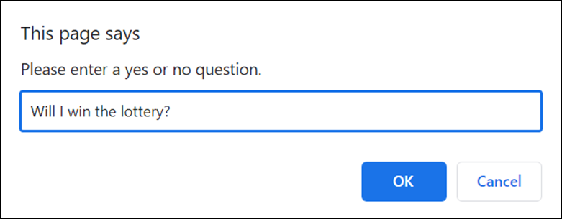
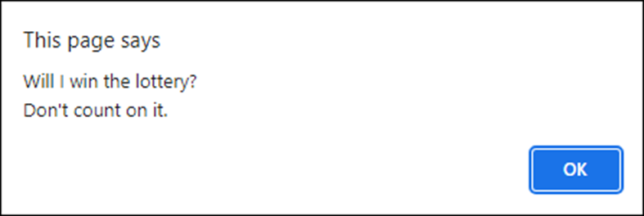
The dialogs for the Magic Eight Ball app
Ask a question
Display the question and answer

Slide 29
JavaScript for the Magic Eight Ball app (part 1)
// get user's question
const question =
prompt("Please enter a yes or no question.")
if (question) {
let answer = "";
// get a random number from 1 to 9
const num = Math.ceil(Math.random() * 9);
switch (num) {
case 1:
answer = "It is certain.";
break;
case 2:
answer = "Reply hazy, try again.";
break;
case 3:
answer = "Don't count on it.";
break;

Slide 30
JavaScript for the Magic Eight Ball app (part 2)
// cases 4 through 9 go here
default:
answer = "Something went wrong.";
break;
}
alert(question + "\n" + answer);
} else {
alert("You didn't enter a question.");
}

Slide 31
The syntax of a while loop
while (condition) { statements }
A while loop that gets the sum of the numbers 1 through 5
let sum = 0;
let i = 1;
while (i <= 5) {
sum += i; // adds i to sum
i++;
}
alert(sum); // displays 15

Slide 32
A while loop that makes sure a user enters a positive number
let years = parseInt(prompt("Enter number of years."));
while (isNaN(years) || years <= 0) {
years = parseInt(prompt(
"Years must be a valid positive number."));
}

Slide 33
The syntax of a do-while loop
do { statements } while (condition);
A do-while loop that makes sure a user enters a positive number
let years = null;
do {
years = parseInt(prompt("Enter number of years.\n" +
"(Must be valid positive number)"));
}
while (isNaN(years) || years <= 0);

Slide 34
The syntax of a for statement
for (counter-initialization; condition; increment-expression) {
statements
}
A for loop that get the sum of the numbers 1 through 5
let sum = 0;
for (let i = 1; i <= 5; i++) {
sum += i; // adds i to sum
}
alert(sum); // displays 15

Slide 35
A for loop that calculates the future value of an investment
const investment = 10000;
const annualRate = 7.0;
const years = 10;
let futureValue = investment;
for (let i = 0; i < years; i++) {
futureValue += futureValue * annualRate / 100;
}
alert(futureValue.toFixed(0)); // displays 19672

Slide 36
A for loop that increments the counter by two
let message = "";
for (let i = 0; i <= 10; i += 2) {
message += i + " ";
}
alert(message); // displays 0 2 4 6 8 10

Slide 37
A for loop that decrements the counter
let message = "";
for (let i = 3; i > 0; i--) {
message += i + "...";
}
message += "Blast off!";
alert(message); // displays 3...2...1...Blast off!

Slide 38
The break statement in a while loop
let number = 0;
while (true) {
number = parseInt(
prompt("Enter a number from 1 to 10.") );
if (isNaN(number) || number < 1 || number > 10) {
alert("Invalid entry. Try again.");
} else {
break;
}
}
alert(number);

Slide 39
The continue statement in a for loop
let sum = 0;
for (let number = 1; number <= 40; number++) {
if (number % 5 !== 0) {
continue; // if number isn't divisible by 5
}
sum += number;
}
alert(sum); // displays 180

Slide 40
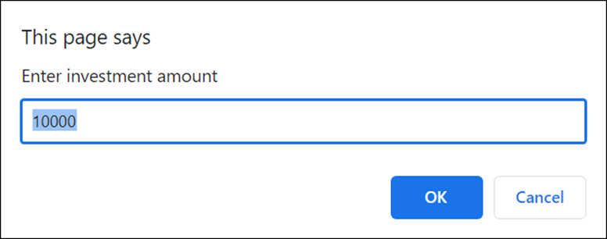
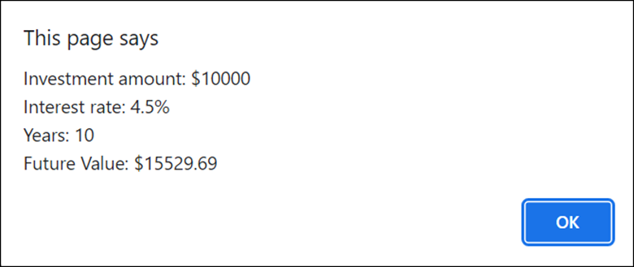
Dialogs for the Future Value app
An input dialog with a default value
The dialog that displays the future value

Slide 41
JavaScript for the Future Value app (part 1)
// use a loop to get a valid investment amount
let investment = NaN;
while (isNaN(investment)) {
investment = parseFloat(
prompt("Enter investment amount", 10000));
}
// use a loop to get a valid interest rate
let rate = NaN;
while (isNaN(rate)) {
rate = parseFloat(prompt("Enter interest rate",
4.5));
}
// use a loop to get a valid number of years
let years = NaN;
while (isNaN(years)) {
years = parseInt(prompt("Enter years", 10));
}

Slide 42
JavaScript for the Future Value app (part 2)
// calulate future value
let futureValue = investment;
for (let i = 0; i < years; i++) {
futureValue += futureValue * rate / 100;
}
// display results
alert("Investment amount: $" + investment + "\n" +
"Interest rate: " + rate + "%\n" +
"Years: " + years + "\n" +
"Future Value: $" + futureValue.toFixed(2));

